Slide 1


Slide 2
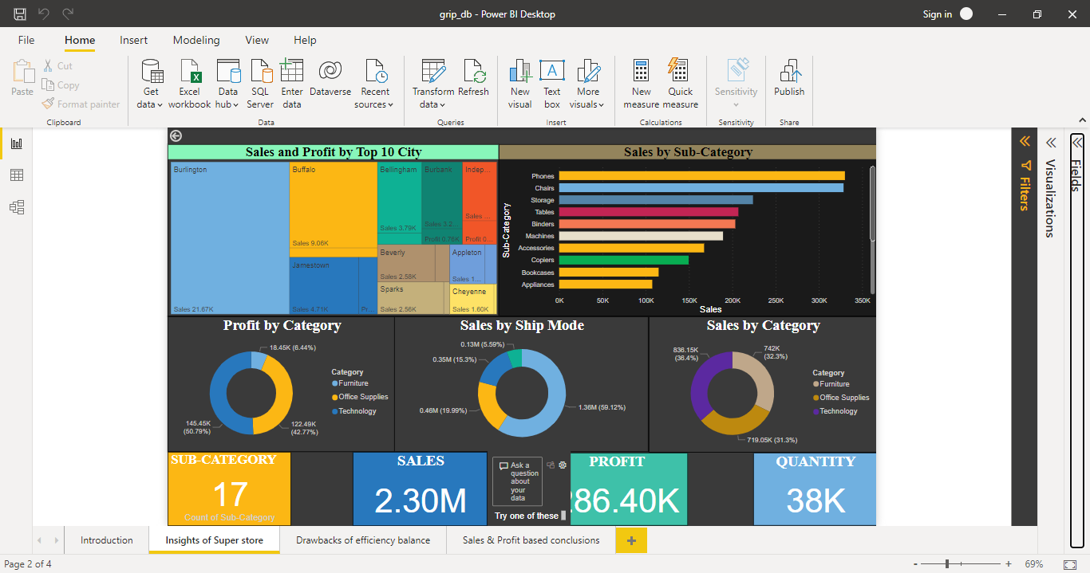
Insights of Super store

Slide 3
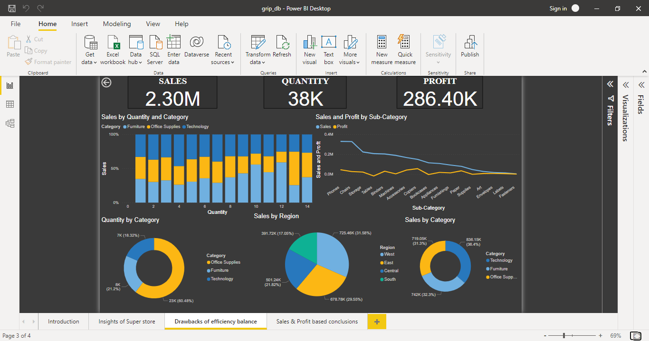
Drawbacks of efficiency balance

Slide 4
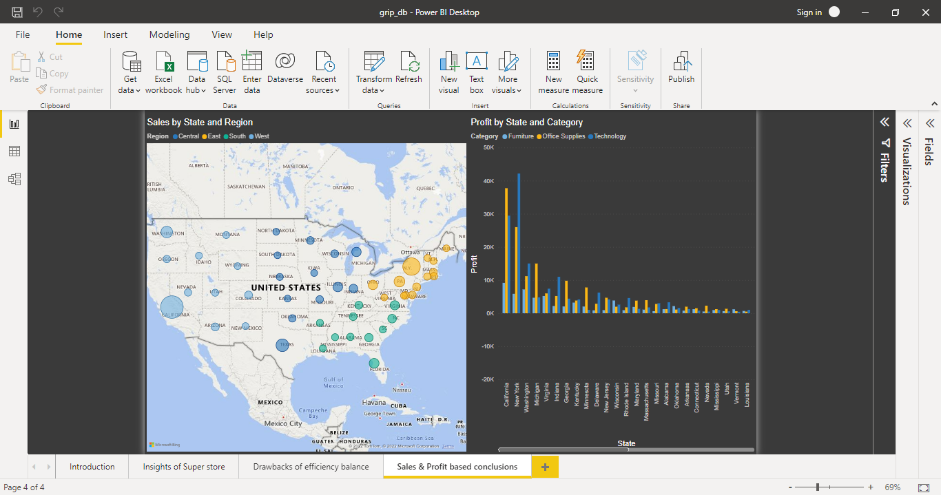
Sales and profit based conclusions

